Slide 1


Project -6
Data-driven insights for
Digital Marketing
Campaigns

Slide 2
Traffic Acquisition & Campaign Performance Analysis (GA4)
Tools : Excel ( Data cleaning and preprocessing
Power BI ( Visualization & Dashboard)
Topic : Digital Marketing using BI tools
Presented by : Shakthi sivaranjani .R

Slide 3
Project objective
Objectives
Analyze digital marketing campaign performance
Evaluate channel effectiveness using KPIs
Provide actionable, data-driven recommendations
Why analysis is important ?
Identify high-performing channels
Optimize ROI and engagement
Support strategic marketing decisions

Slide 4

Data set over view
Data source :
Google Analytics 4 (Traffic Acquisition data)
1.Data Collection – GA4 dataset
2.Data Cleaning – handling missing values & formatting
3.KPI Identification – ROI, CPS, Engagement, Key Events
4.Dashboard Creation – Power BI

Slide 5
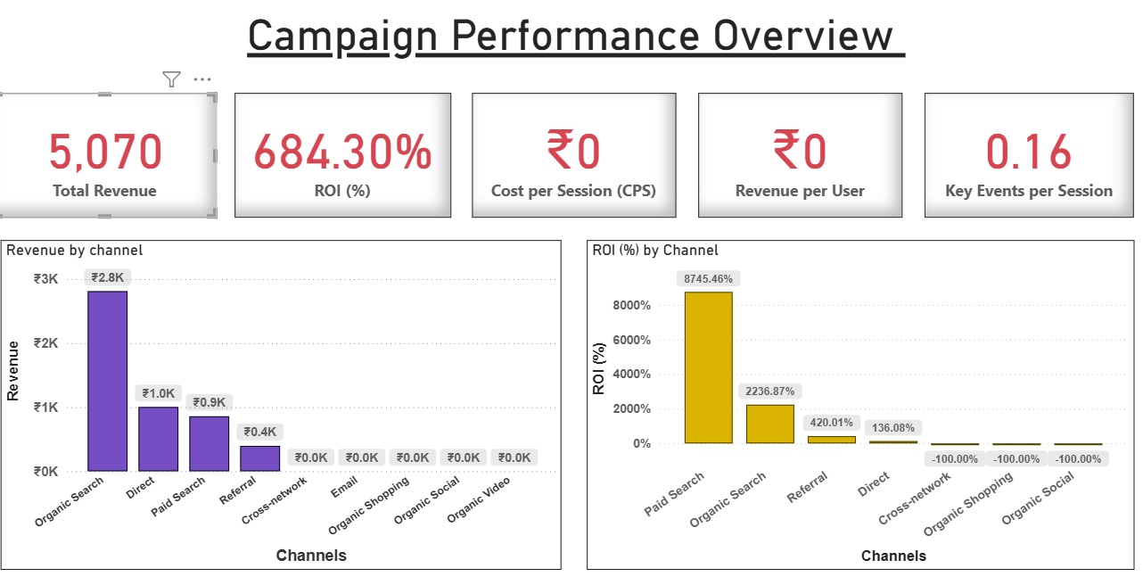
Dashboard Visualization-1
Insights , recommendations ----->

Slide 6
Dashboard - 1 Key Insights & Recommendations
Insights :
Recommendations:
  Organic search generates the highest revenue
  Increase focus on Organic Search because it brings stable revenue.
2. Paid Search shows extremely high ROI
2.Optimize Paid Search carefully to maintain high ROI.
3. Direct traffic gives steady but moderate results
3.Review or redesign low-revenue channels.
4.Some channels generate traffic but no revenue
4.Allocate budget based on both revenue and ROI, not ROI alone.

Slide 7
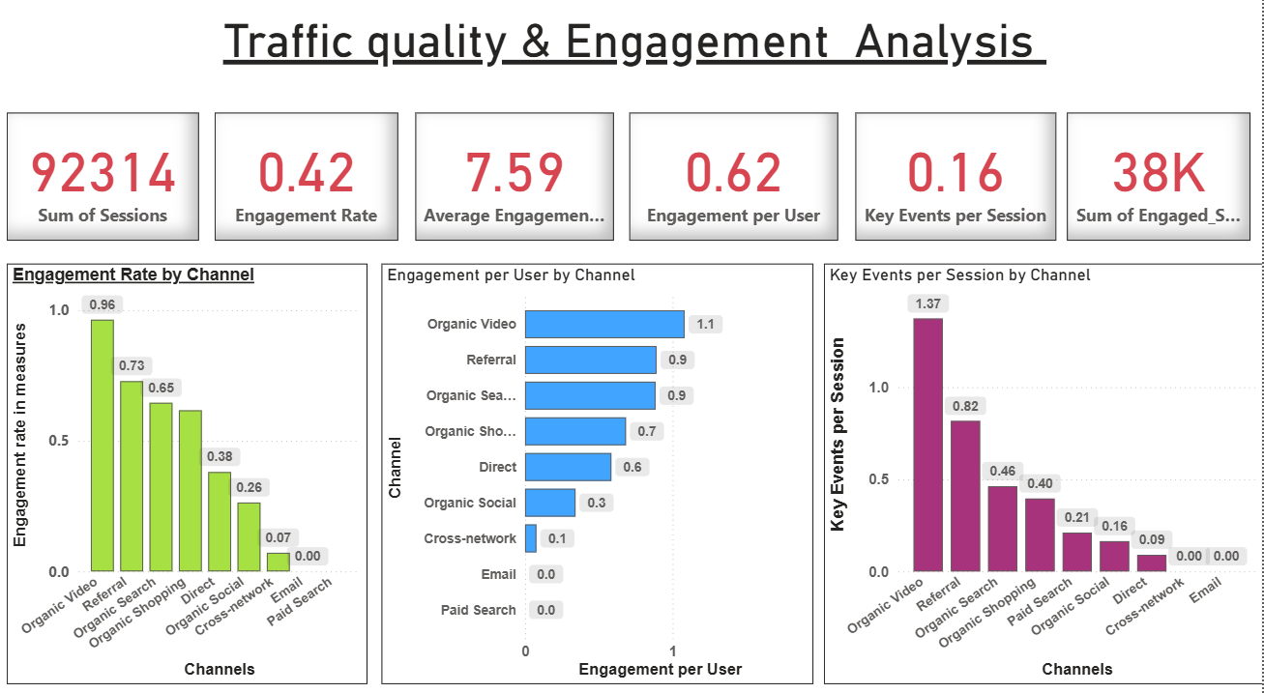
Dashboard Visualization-2
Insights , recommendations ----->

Slide 8
Dashboard - 2 Key Insights & Recommendations
Insights :
Recommendations:
  Organic Video has the highest engagement
  Invest more in high-engagement channels like Organic Video.
2. Referral traffic shows strong user quality
2.Improve website content and call-to-action elements.
3. High sessions do not always mean high
engagement
3.Optimize landing pages to increase conversions.
4.Overall conversion actions are low
4.Focus on improving user experience, not just traffic numbers.

Slide 9
Conclusion
As a Digital marketing consultant
This project used data analytics and dashboards to evaluate the performance of digital marketing campaigns across multiple channels. The analysis helped identify high-performing channels in terms of revenue, ROI, and user engagement. Insights from the dashboards support data-driven decisions to optimize marketing spend and improve campaign effectiveness. Overall, the project demonstrates how analytics can enhance ROI and client satisfaction through better strategic planning.

Slide 10
Thank You
Presented by : Shakthi sivaranjani .R

